Slide 1
ENTRÉE INTO RE- SEARCH VIA THE CASE REPORT/STUDY
Anthony L. Rosner, Ph.D., LL.D. [Hon.]
Medical Information Services
Watertown, MA, 02472-4149
ICAK-US
February 22, 2024

Slide 2
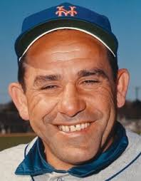
ROAD MAP: CLEAR SENSE OF ORGANIZATION
“You’ve got to be very careful. If you don’t know where you’re going, you might wind up someplace else.”
--Yogi Berra

Slide 3
OUTLINE OF PRESENTATION
1. Historical background and distinctions.
2. Sources of evidence.
3. Strength of evidence.
4. Components.
5. Writing.
6. Reception.
7. Hallmarks.
8. Strengthening a case report.
9. Final checklist.
10. Example of outstanding case report.

Slide 4
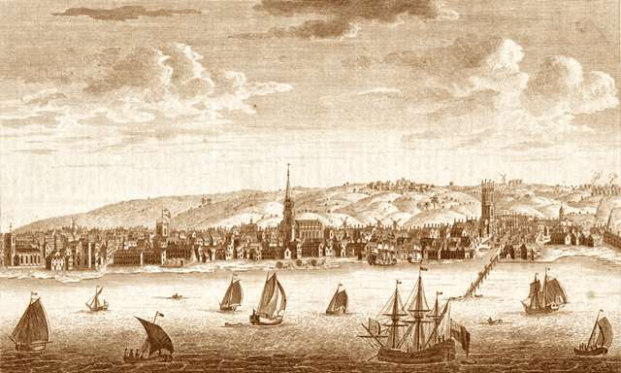
HISTORICAL BACKGROUND

Slide 5
HISTORICAL BACKGROUND
1. Civilizations have maintained their appreciation of storytelling: oral
history, lyrics to music, written works through the centuries.
2. SIMPLEST DEFINITION: The case report is a means of formalizing
clinical stories:
a. Predominating characteristic is descriptive.
b. Description is the bedrock upon which scientific endeavor exists.¹
3. In the middle ages, things were different:
a. Theory rather than observation was dominant.
b. Autopsy was forbidden, physical examinations as such were not
performed.
c. Diagnoses associated with curses, witches, humors, and stars.
d. Sir Thomas Sydenham in 17th century declared that physician’s
role was therapy.
__________________________________________________________________________________________
¹Bromley D. The Case Study in Psychology and Related Disciplines. New York, NY: John Wiley & Sons, 1986.

Slide 6
KEY DISTINCTION
1. Qualitative Case Study: An approach to research that facilitates
exploration of a phenomenon within its context using a variety
of data sources:¹
a. Ensures that issue is not explored through one lens, but
a variety of lenses.
b. As such, encompasses much more complexity.
2. Case Report: Familiar way of sharing events or efforts of inter-
vening with single patients to investigate efficacy/side effects.^{1,2}
a. N of 1 (single-subject) clinical trial, using an individual pa-
tient as sole unit of observation to investigate the efficacy
or side –effect profile of different interventions.
________________________________________________________________________________________________________
¹Baxter P, Jack S. Qualitative case study methodology: Study design and implementation for novice researchers. The Qualitative
Report 2008; 13(4): 544-559.
²Alpi KM, Evans JJ. Distinguishing case study as a research method from case reports as a publication type. Journal of the Medical
Library Association; 2019; 107(1):
______________________________________________________________________________________________
¹Baxter P, Jack S. Qualitative case study methodology: Study design and implementation for novice researchers. The Qualitative Report
2008; 13(4): 544-559.

Slide 7
CASE STUDY IN MORE DETAIL
“Case study research is defined as a qualitative ap-
proach in which the investigator explores a real-life,
contemporary bounded system (a case) or multiple-
bound systems (cases) over time, through detailed,
in-depth data collection involving multiple sources of
information, and reports a case description and case
themes. The unit of analysis in the case study might
be multiple cases (a multisite study) or a single case
(a within-site case study).¹
________________________________________________________________________________________________________
¹Creswell JW. Qualitative Inquiry and Research Design Choosing among Five Approaches, 4th Edition. Los Angeles, CA: SAGE, 2018.

Slide 8
TERMS OF THE CASE STUDY: Purpose
1. Most conducive to shedding light upon “how” and “why” certain
events are seen to occur.
2. First line of evidence in a clinical inquiry, able to describe mistakes in
diagnosis and their causes and consequences.¹
a. Prompting, supporting or refuting a hypothesis.
b. Describing unusual or puzzling clinical features.
c. May draw attention to a potential danger in practice.
d. Could point out an alternative or obscure [but important] clinical
understanding regarding a condition.
e. Contribute to a better understanding of clinical practice.
________________________________________________________________________________________________________
¹Janicek M. Clinical Case Reporting in Evidence-Based Medicine.. Oxford, UNITED KINGDOM: Butterworth-Heinemann, 1999.

Slide 9
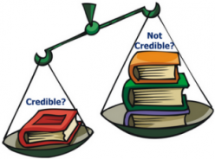
SOURCES OF EVIDENCE
________________________________________________________________________________________________________

Slide 10
CASE STUDY SOURCES OF EVIDENCE¹
ACTUAL EVIDENCE SOURCES
1. Interviews.
2. Documentation.
3. Archival records.
4. Direct observations.
5. Participant-observations.
6. Physical artifacts.
STUDY METHODOLOGY
1. Gathering data. Triangulation
2. Sense-making.
3. Triangulating multiple data streams.
__________________________________________________________________________________________________________________
¹Alpi K, Evans JJ. Distinguishing case study as a research method from case reports as a publication type. Journal of the Medical Library
Association 2019; 107(1).
__________________________________________________________________________________________
¹B

Slide 11
TERMS OF THE CASE STUDY: Sources of Evidence¹
1. Documentation: Literature and other written reports. If contradictory,
an excellent rationale for conducting the case study.
2. Archival Records: Service or organizational records, lists, maps, and
charts.
3. Interviews: May be either open-ended or focused:
a. Questions must not be leading to produce bias.
b. Especially subject to bias, poor recall, or inaccurate or poor
articulation.
4. Direct Observation: Using multiple observers increases reliability.
5. Participant Observation: Generated when observer occupies an insi-
der’s role:
a. Most commonly found in anthropological studies.
b. Caveat: Embedded observer may assume role of advocacy.
6. Physical Artifacts: Technological devices, tools, or works of art.
________________________________________________________________________________________________________
¹Yin RK. Case Study Research: Design and Methods. Beverly Hills, CA: Sage, 1989, pp. 85-95.

Slide 12
STRENGTH OF EVIDENCE
________________________________________________________________________________________________________

Slide 13
HIERARCHY OF CLINICAL RESEARCH DESIGNS
Design Classification Definition
1. Randomized Clinical Trial [RCT] Defined treatment to one group, pla-
cebo or sham to a second [control]
2. Prospective [Cohort] Study Defined treatment to one group, no
control blank or sham group
3. Retrospective Study Study done after treatment
4. Cross-sectional Study Study of all subjects, one time point
5. Single Subject Time Series Following of response of one case
over time
6. Case Series Report on a group of cases
7. Case Report Report on a single case
8. Anecdotes Recollections of case responses,
lacking the details of case report

Slide 14
HIERARCHY OF CLINICAL RESEARCH DESIGNS

Slide 15
APPROPRIATENESS OF THE CASE REPORT
1. Offers superior external validity:¹
a. Examine people in close to real situations.
b. Do not impose experimental manipulations, artificial conditions.
2. High feasibility.
3. Low cost.
4. Transparency of results:
a. Each person serves as own control.
b. Group designs can mask individual changes.^{2,3}
c. Excellent teaching tool, bridging gap between general principles
and actual clinical practice.
5. Capable of supporting or modifying a theory.
__________________________________________________________________________________________
¹Kratochwill TR, Mott SE, Dodson CL. Case study and single case research in clinical and applied psychology. In Hersen ASBM,
ed. Research Methods in Clinical Psychology. New York, NY: Pergamon, 1984.
²Aldridge D, Pietroni P. Research trials in general practice towards a focus on clinical practice. Family Practice 1987; 4: 311-315.
³Wulff H. Single case studies: An introduction. Scandinavian Journal of Gastroenterology Supplement 1988; 147: 7-10.

Slide 16
DISADVANTAGES OF THE CASE REPORT
1. Using an uncontrolled environment, becomes subject to confounding:
a. Change in patient attitude.
b. Change in circumstance.
c. Clinical insight of patient who reflects upon own case.¹
2. Treatment effects may be carried over from one therapeutic intervention to
another if multiple strategies are applied sequentially. Can alleviate with
intervening period of no treatment [called a wash-out], but this may
not be sufficient.
__________________________________________________________________________________________
¹Aldridge D. Goal setting: The patient’s assessment of outcome and recognition of therapeutic change. Comparative Medical Re-
search 1988; 3: 89-97.

Slide 17
COMPONENTS
__________________________________________________________________________________________

Slide 18
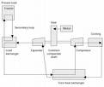
TERMS OF THE CASE REPORT: Components¹
1. Title: Should include intervention, outcomes, population under study,
and condition treated.
2. Abstract: To arouse interest: What was the case and what was unusual
about it.
3. Introduction: Clearly state the purpose of the paper with case being
discussed in perspective.
4. Case Report [Methods]: Case itself is presented, usually in chronologi-
cal fashion.
5. Discussion: Significance of the case, brought forth by author’s opi-
nions.
6. Conclusion: What was learned from the case study, related to purpose.
7. References: Primarily but not necessarily exclusively drawn from peer-
reviewed journal articles.
________________________________________________________________________________________
¹Green BA, Johnson CD. Writing patient reports for peer reviewed journals: Secrets of the trade. Journal of Sports Chiropractic
and Rehabilitation 2000; 14(3): 51-59.

Slide 19
TERMS OF THE CASE REPORT: Structured Abstract¹
1. Objective: Clear statement of the purpose of the paper.
2. Clinical Features: Most salient portions of the case, focusing upon pri-
mary aspects of patient’s condition and main outcome measures used
to track progress.
3. Intervention and Outcome: Methods used to care for and assess the
patient, summarizing outcomes of care.
4. Conclusion: Summary as to how case contributed to literature, stating
overall deduction learned from study.
5. Key Words: Terms found in the Index Medicus database, called medical
subheadings [MeSH]. Can be located at PubMed home page at http://
www.ncbi.gov/entrez/query/fcgi or at http://eee.nim.gov/mesh/meshome.
html.
________________________________________________________________________________________
¹Lawrence D, Mootz RD. Streamlining manuscript submission to scientific journals: Editor’s presentation, Research Agenda Con-
ference 3. Journal of the Neuromusculoskeletal System 1998; 6(4): 161-167.

Slide 20
TERMS OF THE CASE REPORT: Introduction¹
________________________________________________________________________________________
1. This brings into play previous studies that describe the
problem being addressed in the patient(s).
2. All descriptions should be annotated, with published studies
preferred.
3. The key is to be able to describe the GAP (where previous
studies fall short or are flawed) and how the current
narrative may help to fill the void.

Slide 21
TERMS OF THE CASE REPORT: Case Report [Methods]¹
Relies primarily upon notes taken upon patient’s visit, not needing to in-
clude information about what is normal and has no bearing upon the
case. It includes:
1. The chief complaint.
2. History of the present illness.
3. The patient’s past history.
4. The physical examination.
5. The laboratory examination.
6. Special tests [e.g. radiology, orthopedic, neurologic].
7. Diagnosis.
8. Therapeutic measures taken.
9. The patient’s clinical course.
10. The final outcome.
_________________________________________________________________________________________________________
¹Peterson B. The case report. Journal of the American Osteopathic Association 1975; 75: 352-355.

Slide 22
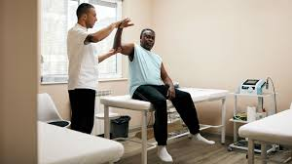
TERMS OF THE CASE REPORT: Case Report: Results
_________________________________________________________________________________________________________
11. This is a chronological narrative starting with what is
observed or described by the patient upon presentation.
2. It continues with a stepwise description of interventions and
their timing, including how they are tolerated by the patient.
3. It includes descriptions of what is experienced in terms of the
initial complaint over time between visits.
4. It concludes with what is experienced by the patient after the
final intervention.

Slide 23
TERMS OF THE CASE REPORT: Discussion
Primary purpose is to educate the reader and includes:¹
1. Overview of how the case is typically managed, may include a brief re-
port of the history of the condition.
2. Differential diagnoses and how they were included or eliminated.
3. Review of the literature to allow reader to make comparisons with what
has already been established [if not in the Introduction].
4. Rationale for the management of the patient discussed.
5. Frank discussion of the strengths and weaknesses of the approach
taken.
6. Suggestions or hypotheses regarding outcome of case and why care
provided may or may not have been beneficial.²
7. Suggestions outlining further research into topics discussed.
_________________________________________________________________________________________________________
¹Green BA, Johnson CD. Writing case reports for peer reviewed journals: Secrets of the trade. Journal of Sports Chiropractic and
Rehabilitation 2000; 14(3): 51-59.
²Squires BP. Case reports: What editors want from authors and peer reviewers. Canadian Medical Association Journal 1989;
141(5): 379-380.

Slide 24
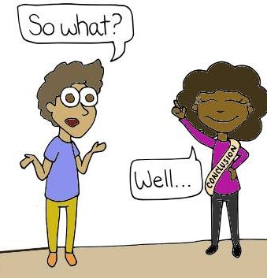
TERMS OF THE CASE REPORT: Conclusions:
_________________________________________________________________________________________________________
1. This should be composed of a paragraph summarizing the
condition(s) presented, the intervention, and whatever
outcome relating to the initial complaint was experienced
by the patient.
2. It may also include suggestions for follow-up treatment(s) as
well as implications as to what further research into the topic
may be indicated by the results.

Slide 25
TERMS OF THE CASE REPORT: References
1. Provide supporting information relating to disorder under study, clini-
cal measures taken, and decision to be considered after reading the
report.¹
2. Formatting is done in accordance with the instructions to the author
provided by a particular journal or in the Uniform Requirements for ar-
ticles submitted to biomedical journals.²
3. If search turned up no publications, this should be noted together with
the time period searched.
_________________________________________________________________________________________________________
¹Janicek M. Clinical Case Reporting in Evidence-Based Medicine. Oxford, UNITED KINGDOM: Butterworth-Heinemann, 1999.
²International Committee of Medical Journal Editors. Uniform requirements for manuscripts submitted to biomedical journals. New
England Journal of Medicine 1991; 324: 424-428.

Slide 26
TERMS OF THE CASE REPORT: Optional Inclusions
1. Acknowledgments: Recognition extended to the work of colleagues
who have assisted:
a. Could include proofreader or person providing ideas for paper.
b. Individuals recognized must give their consent with a brief signed
statement.
2. Tables: Simple and self-contained:
a. If previously published, need written permission from publisher
of original.
b. Formatting should follow specification of journal or Uniform Re-
quirements.¹
3. Figures: Highly attractive, heighten accessibility of outcomes:
a. If previously published, need written permission from publisher.
b. Formatting should follow specification of journal or Uniform
Requirements.¹
_________________________________________________________________________________________________________
¹International Committee of Medical Journal Editors. Uniform requirements for manuscripts submitted to biomedical journals. New
England Journal of Medicine 1991; 324: 424-428.

Slide 27
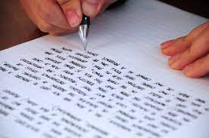
WRITINGS
_________________________________________________________________________________________________________

Slide 28
WRITING A CASE REPORT: Merits of Publishing
1. Author is performing an invaluable service in alerting others to a
phenomenon regarded as noteworthy.
2. Some have gone on to alter the entire course of medicine.
3. Every larger study, including the “gold standard” randomized cli-
nical trial, owes its existence to original observations usually
made in case studies.
4. For individual authors, publishing offers the chance to establish
their own credibilities and expertise in the field, becoming au-
thorties in the process.

Slide 29
WRITING A CASE REPORT: General Submission Requirements
1. Full author information usually is listed on a title page but not else-
where so that reviews can be blinded.
2. Each of the primary sections [Abstract, Introduction, Case Report,
Discussion, Conclusions, References, Acknowledgments, Tables,
Figures] should begin on a separate page.
3. Pages must be numbered consecutively, beginning with the title
page, on bottom or upper right-hand corner.
4. Running titles [shortened versions of the original title] should be
entered on the upper left-hand corner of every page.
5. References should be cited and listed in the style guide of the journal.
6. Illustrations must be camera ready.

Slide 30
WRITING A CASE REPORT: General Article Considerations
1. Journal Choice: Driven by content of journal as well as readership,
plus author’s own estimation of the likelihood of the article’s being
accepted.
2. Coauthors: Lead authors should choose their coauthors on basis
of reliability as well as compatibility.
3. Literature Search: Authors not familiar with electronic search engines
should consult a librarian who knows how to set up complex sear-
ches on given topics.
4. Writing Style: Overarching directive: communicate in a plain style.
5. General Submission Requirements: Articles must follow specification
of journal or Uniform Requirements.¹
_________________________________________________________________________________________________________
¹International Committee of Medical Journal Editors. Uniform requirements for manuscripts submitted to biomedical journals. New
England Journal of Medicine 1991; 324: 424-428.

Slide 31
WRITING A CASE REPORT: Journal Choice
Some of the current leading peer-reviewed and indexed journals in
chiropractic are the:
Journal of Manipulative and Physiological Therapeutics
Chiropractic and Osteopathy [Electronic]
Journal of the Canadian Chiropractic Association
Chiropractic Journal of Australia
Spine
Journal of Chiropractic Medicine

Slide 32
WRITING A CASE REPORT: Literature Search
Some of the current available databases include:
1. MANTIS [Manual Alternative and Natural Therapy Index System]
URL: http://www.healthindex.com
2. CINAHL [Cumulative Index to Nursing and Allied Health Literature]
URL: http://www.cinahl.com
3. PUBMED/MEDLINE
URL: http:/PubMed.gov
4. AMED [Allied and Contemporary Medicine]
URL: www.bl.uk/collections/health/amed.html
5. ICL: Index to Chiropractic Literature
URL: http://www.chiroindex.org
6. The Cochrane Library
URL: http://www.thecochranelibrary.org

Slide 33
A WORD ABOUT FIRST DRAFTS….

Slide 34
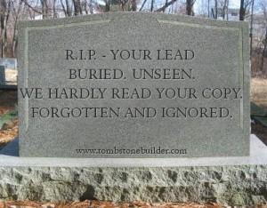
“YOU BURIED THE LEAD*!”
*Actually, in publishing, the correct word is “lede.”

Slide 35
AVOID AT ALL COSTS…..
REJECTION: The necessary tools of rhetoric are lacking
in your manuscript, proposal, course, or other offering:
1. Arcane language.
2. Lack of focus.
3. No clear demarcation between background (what is
known) and what you offer as:
a. A knowledge gap.
b. A paradox.
c. Outright falsehood.

Slide 36
SPECIFIC AIMS: EFFECTIVE OPENINGS
INTRODUCTORY PARAGRAPH:
Recommended structure:
A. What is Unknown:
1] Gaps in the knowledge base.
2] Show how your research will address and fill this gap.
B. The Critical Need:
1] The reason your submission should be noticed (and funded,
where applicable).
2] Emphasize the significance of the problem you are trying to
address.
3] Show how this submission represents the next logical step to
advance the field.
_________________________________________________________________________________________________________
¹ Michelle S. NIH Grant Applications: The Anatomy of a Specific Aims Page. BioScience Writers April 9, 2005.
http://www.biosciencewriters.com/NIH-Grant-Applications-The-Anatomy-of-a-Specific-Aims-Page.aspx Accessed 05/18/2018.

Slide 37
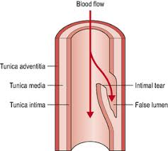
EFFECTIVE OPENINGS
EXAMPLES:
1. Null: “There are numerous studies that sug-
gest that there are a variety of compounds
that may compromise the structure of the
vertebral arteries, including homocysteine.”
2. Positive: Homocysteine has been shown in a
number of studies to weaken the structure of
vertebral arteries.

Slide 38
EDITING TIPS
COMMON ERRORS:
1. Sentence fragments.
2. Sentence sprawl.
3. Misplaced and dangling modifiers.
4. Faulty parallelism.
5. Unclear pronoun reference.
6. Incorrect pronoun case.
7. Omitted commas.
8. Superfluous commas.
9. Comma splices.
10. Apostrophe errors.
11. Words easily confused.
12. Misspellings.
____________________________________________________________________________

Slide 39
EDITING TIPS
1. Dangling modifiers:
NO: When writing, an original task was proposed.
YES: When writing, a student proposed an original task.
2. Faulty parallelism:
NO: His goals include winning the game and an educational system.
YES: His goals include winning the game and proposing an edu-
cational system.
3. Unclear pronoun reference:
NO: He was a brilliant scholar. This is how he explained the novel.
YES: He was a brilliant scholar who was able to explain the novel.
4. Incorrect pronoun case:
NO: John’s campaign led to a conflict between he and the Pope.
YES: John’s campaign led to a conflict between him and the Pope.
____________________________________________________________________________

Slide 40
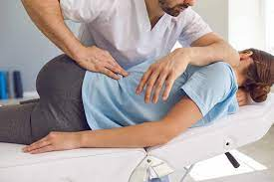
WRITING A CASE REPORT: Example: Description of Chiropractic Technique
Full range of descriptors should be provided. Consider:
1. Position of the subject.
2. Position of the doctor.
3. Specific contact point.
4. Line of thrust.
5. Approximate amplitude.
6. Frequency of application.
7. How frequently patient was seen.
8. How often adjustments were given.
9. How long patient was monitored.
10. Any additional procedures.
WITH FEW EXCEPTIONS, MOST OF THESE ARE NOT REPORTED IN
TODAY’S LITERATURE.

Slide 41
WRITING A CASE REPORT: Statistical Analysis
1. Contrary to intuition, possible in a case design provided that there
is a sufficient number of matched data points [such as in a time se-
ries.
2. Diurnal variations in patients may confound the results: For certain
physiological functions, may have to be accounted for by taking
measurements at the same time each day.
3. If time becomes a variable, alternative approach would be to search
for patterns over varying time periods.¹
________________________________________________________________________________________________________
¹LeBlanc A. Quantitative analysis of cardiac arrhythmias. Critical Reviews in Biomedical Engineering 1986; 14(1): 1-43.

Slide 42
RECEPTION OF THE CASE REPORT
________________________________________________________________________________________________________

Slide 43
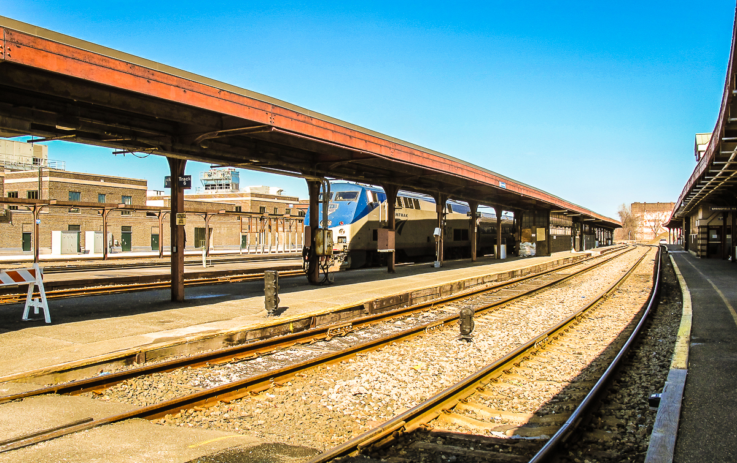
AVOID AT ALL COSTS…..
“Your train of thought has left the station.”
--Dorothy Parker

Slide 44
WRITING A CASE REPORT: Reviewers
1. Submitted paper is turned over to 2-3 reviewers, recognized authori-
ties in field closely related to that of manuscript being reviewed.
2. Best means of preparation:
a. Make sure that paper clearly states and achieves its purpose.¹
b. Vet manuscript through other individual(s) to catch basic er-
rors in logic, inappropriate or unclear use of language, or me-
chanical errors.
3. Returned papers:
a. Accept, accept with minor revisions, accept subject to accep-
tance of major revisions, reject.
b. Look for constructive elements whenever possible.
c. Best reviews list both good and bad points of manuscript.
d. Option to refute issues that reflect misunderstanding/ignorance.
e. Worst-case scenario is not to have submitted in first place.
f. Another journal can be chosen, process repeated: Needs time.
_________________________________________________________________________________________________________
¹McMaster BA. Writing the case study: Both ends meet. Palmer Journal of Research 1995; 2(3): 59-62.

Slide 45
WRITING A CASE REPORT: Readers
1. Like reviewers, readers also seek a clear statement of purpose in
the paper.
2. Diversity demands that author provide attractive Introduction:
a. Identifying the clinical setting for the case.
b. Describing what is not known about the normal outcome of si-
milar cases.
c. Laying foundation for what is to follow with statement of purpose.
3. By documenting conflicting or unresolved opinions, author creates
excellent evidence for need to consider paper such as this.
4. Attractive is increased by:
a. Demonstrating, if possible, that practitioner is likely to encoun-
ter this patient; dire consequences if condition not identified.
b. Demonstrate emotional, social, and economic impact of the
problem upon patient, family, and healthcare delivery system.¹
_________________________________________________________________________________________________________
¹Gleberzon BJ, Killinger LZ. The journal article cookbook. Journal of Manipulative and Physiological Therapeutics 2004; 27(7):
481-492.

Slide 46
HALLMARKS
_________________________________________________________________________________________________________

Slide 47
STRENGTHENING A CASE REPORT: Hallmarks of a Good Case Report
1. Especially compelling case study takes pains to develop a theoretical
framework, keeping in mind that theory:
a. Is a guiding principle for designing good research and data col-
lection.
b. Is the principal vehicle for generalizing the results of the study.
2. Good and frequent questions must be asked during data collection:
a. Investigator needs to be a good listener, assimilating large
amounts of information without bias.
b. Investigator needs to maintain flexibility, reading between lines.
3. Most thorough and conscientious of authors will sift their papers
through critical colleagues to see if there are alternative explanations
of data that can be provided.

Slide 48
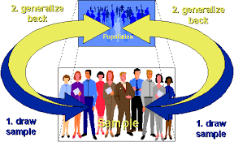
TERMS OF THE CASE REPORT: Generalizability
1. Statistical:
a. Inference is made about a population on the basis of empirical
data which is collected about a sample.
b. Out of domain of case study.
2. Analytic:
a. Previously developed theory is used as a template with which
to compare the results of a study.
b. Basis to generate new theories, shown by historical examples
of landmark cases.

Slide 49
LANDMARK CASE REPORTS
1. Reputation of Sigmund Freud.¹
2. First demonstration of anesthesia.²
3. Addison’s disease.³
4. Paget’s disease.⁴
5. Cushing’s disease.⁵
_______________________________________________________________________________________________________
¹Pletsch C. Freud’s case studies. Partisan Review 1982; 49(1): 101-118.
²Squire W. On the introduction of ether inhalation as an anesthetic in London. The Lancet 1888; 132: 1220-1221.
³Addison T. On the constitutional and local effects of disease of the supra-renal capsules. London, UNITED KINGDOM: Samuel
Highley, 1855.
⁴Paget J. On a form of chronic inflammation of bones [ostetis deformans]. Transactions of the Medico-Chirugical Society 1877;
60: 235-256.
⁵Cushing H. The Pituitary Body and Its Disorders. Philadelphia, PA: JB Lippincott Company, 1912.

Slide 50
LANDMARK CASE REPORTS
6. Treatment of empyema with intrapleural fibrinolytics as therapeutic
agents.⁶
7. Carotid endarterectomy.⁷
8. Human cardiac transplants.⁸
9. Link between acquired Immunodeficiency Syndrome and Human Im-
munodeficiency Syndrome.⁹
_______________________________________________________________________________________________________
⁶Tillett WS, Sherry S. The effect in patients of streptococcal fibrinolysin [streptokinase] and streptococcal desoxyribonuclease on
fibrous, purulent, and sanguinous pleural exudations. Journal of Clinical Investigation 1949; 28: 173-190.
⁷Eastcott HHG, Pickering GW, Rob CG. Reconstruction of internal carotid artery in a patient with intermittent attacks of hemiple-
gia. The Lancet 1954 2; 994-996.
⁸Barnard CN. A human cardiac transplant: An interim report of a successful operation performed at Groote Schuur Hospital, Cape
Town. South African Medical Journal 1967; 41: 1271-1274.
⁹Anonymous. Kaposi’s sarcoma and Pneumocystitis pneumonia among homosexual men: New York City and California. Morbidity
and Mortality Weekly Report 1981; 30(25): 305-308.

Slide 51
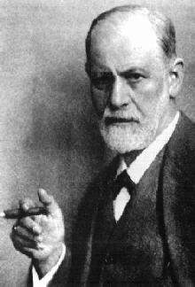
LANDMARK CASE REPORT: Reputation of Sigmund Freud¹
Established by his case descriptions of “Little Hans” and “The Rat
Man” near the beginning of the 20th century.
__________________________________________________________________________________________
¹Pletsch C. Freud’s case studies. Partisan Review 1982; 49(1): 101-118.

Slide 52
LANDMARK CASE REPORT: First Demonstration of Anesthesia¹
By William Morton in the United States in 1846 and by William
Squire in 1888 in London.
______________________________________________________________________________________________________
¹Squire W. On the introduction of ether inhalation as an anaesthetic in London. The Lancet 1888; 132: 1220-1221.

Slide 53
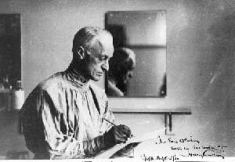
LANDMARK CASE REPORT: Cushing’s Disease¹
Described by Harvey Cushing as a pituitary disorder in 1910.
__________________________________________________________________________________________
¹Cushing H. The pituitary body and its disorders. Philadelphia, PA: JB Lippincott Company, 1912

Slide 54
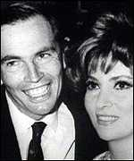
LANDMARK CASE REPORT: Human Cardiac Transplants¹
Introduced at the Groote Schuur Hospital in Cape Town, South
Africa, described by Christiaan Barnard in 1967.
__________________________________________________________________________________________
¹Barnard CN. A human cardiac transplant: An interim report of a successful operation performed at Groote Schuur Hospital in
Cape Town. South African Medical Journal 1967; 41: 1271-1274.

Slide 55
STRENGTHENING A CASE REPORT

Slide 56
STRENGTHENING A CASE REPORT: Components of the Exemplary Case Report¹
1. Significance: Subject is of unusual and general public interest.
2. Completeness: Attention paid to boundaries between the case
and its context, with absence of artificial limits [exhaustion of
time and money].
3. Alternative Prospectives: Discussion provided with basis for
their rejection.
4. Sufficient Evidence: Supporting and challenging data included,
convincing the reader that the investigator knows the subject,
acting thoughtfully and steeped in the issues about the case:
a. Multiple cases have equal amounts of attention paid to each.
b. Investigator demonstrates maintenance of chain of events
to insure validity.
5. Composed in an Engaging Manner: Clarity of writing with evidence
of writer’s enthusiasm with hint of seduction for the reader.
________________________________________________________________________________________________________
¹Yin RK. Case Study Research: Design and Methods. Beverly Hills, CA: Sage, 1989, pp. 146-151.

Slide 57
STRENGTHENING A CASE REPORT: Do’s and Don’ts in Writing
1. Intention is to describe and discuss a clinical event, not to prove it:¹
a. Avoid arguing that case study clearly demonstrated cause and
effect by insisting that a given intervention is an effective treatment
for a specified condition.
b. Promoting particular technique or device for profit is especially
unwelcome unless alternatives found to be unproductive.
2. Avoid general terms of intervention such as “chiropractic treatment”
or “high-velocity, low-amplitude thrust.” How could that possibly be
duplicated by another clinician?
GOOD EXAMPLE: A hypothetical patient with a sacroiliac dysfunction
“was treated by using a side-lying SMT procedure, with the doctor
contacting the patient’s posterior superior iliac spine with pisiform.”
________________________________________________________________________________________________________
¹Keating JC. Towards a Philosophy of the Science of Chiropractic: A Primer for Clinicians. Stockton, CA: Stockton Foundation for
Chiropractic Research, 1992; pp. 199-222.
²Gleberzon BJ, Killinger LZ. The journal article cookbook. Journal of Manipulative and Physiological Therapeutics 2004; 27(7):
481-492.

Slide 58
STRENGTHENING A CASE REPORT: Maximizing Reliability
Does the study truly measure what it supposed to?
1. Increasing Reliability: Corroborating documentary evidence, detailed
protocols.
2. Increasing Construct Validity: Multiple sources of evidence creates
a triangulation with converging lines of inquiry;¹ use standardized in-
struments to document a clear chain of evidence.
3. Increasing Internal Validity: Collect data systematically, not anecdo-
tally; create rival theories and evaluate evidence with respect to them.
4. Increasing External Validity: Maintain sensitivity as to how results may
or may not be generalized; consider multiple case studies or case
series.
_________________________________________________________________________________________________________
¹Bromley D. The Case Study in Psychology and Related Disciplines. New York, NY; John Wiley & Sons, 1986.

Slide 59
TERMS OF THE CASE REPORT: Multiple Designs
1. Retrospective: Written after care for the patient has been delivered:
a. Most commonly reported in the literature.¹
b. Simplest to write, most attractive place to begin.
c. Head starts if clinician has already:
1] Recorded valid and reliable outcome measures.
2] Indicated a specific management plan.
3] Kept clear chart notes.
4] Shown proficiency in writing reports to insurance company.
2. Prospective: Predetermined management plan after reviewing literature:
a. Guarantees measurements before, during, and after care.
b. With literature review completed, saves time in writing.
________________________________________________________________________________________________________
¹Keating JC. Towards a Philosophy of the Science of Chiropractic: A Primer for Clinicians. Stockton, CA: Stockton Foundation for
Chiropractic Research, 1992, pp. 199-222.

Slide 60
FINAL CHECKLIST
_____________________________________________________________________________________________________

Slide 61
FINAL CHECKLIST FOR CASE REPORT¹
FOR ALL QUALITATIVE RESEARCH:
1. Is this report easy to read?
2. Does it fit together, each sentence contributing to the whole?
3. Does this report have a conceptual structure (i.e., themes or issues)?
4. Are its issues developed in a scholarly way?
5. Have quotations been used effectively?
6. Has the writer made sound assertions, neither over/under interpreting?
7. Are headings, figures, artefacts, appendices, indexes effectively used?
8. Was it edited well, then again with last minute polish?
9. Were sufficient raw data presented?
10. Is the nature of the intended audience apparent?
11. Does it appear that individuals were put at risk?
________________________________________________________________________________________________________
¹ Hyett N, Kenny A, Dickson-Swift V. Methodology or method? A critical review of qualitative case study reports. Qualtiative Studies on
Health and Well-Being 2014;9:23606.

Slide 62
FINAL CHECKLIST FOR CASE STUDY¹
HIGH RELEVANCE TO QUALITATIVE CASE STUDY RESEARCH:
1. Is the case adequately defined?
2. Is there a sense of story to the presentation?
3. Is the reader provided some vicarious experience?
4. Has adequate attention been paid to various contexts?
5. Were data sources well-chosen and in sufficient number?
6. Do observations and interpretations appear to have been triangulated?
7. Is the role and point of view of the researcher readily apparent?
___________________________________________________________________________________________________________
¹ Hyett N, Kenny A, Dickson-Swift V. Methodology or method? A critical review of qualitative case study reports. Qualtiative Studies on
Health and Well-Being 2014;9:23606.

Slide 63
FINAL ASSESSMENT OF CASE REPORT/STUDY¹
HOWEVER:
Case reports have different meanings and purpose than a case
study. Medical understanding of a case report has been confused
with qualitative case study approaches:
1. Case report lacks methodological grounding and qualities of
research rigor.
2. Traditionally, case report simply describes a single case,
explaining how and what occurred in a selected setting.
___________________________________________________________________________________________________________
¹ Hyett N, Kenny A, Dickson-Swift V. Methodology or method? A critical review of qualitative case study reports. Qualtiative Studies on
Health and Well-Being 2014;9:23606.

Slide 64
OUTSTANDING CASE REPORT: EXAMPLE
___________________________________________________________________________________________________________

Slide 65
OUTSTANDING CASE REPORT¹
1. Describes response of female patient with dysmenorrhea [menstrual
cramping] to chiropractic adjustments and soft tissue therapy.
2. Study used pain diary:
a. Subjective pain rating scale.
b. Extended time series of outcome measurements at 4 months of
baseline readings and 3 following treatment.
3. Description of chiropractic manipulations did not include all details in
a case study, but virtually all other features described earlier included.
4. It is apparent from pain reductions that this particular patient respond-
ed favorably to treatment: Clinical pilot,² full scale study³ followed.
__________________________________________________________________________________________
¹Liebl NA, Butler LM. A chiropractic approach to the treatment of dysmenorrhea. Journal of Manipulative and Physiological Thera-
peutics 1990; 13(2): 101-106.
²Kokjohn K, Schmid DM, Triano JJ, Brennan PC. The effect of spinal manipulation on pain and prostaglandin levels in women with
primary dysmenorrhea. Journal of Manipulative and Physiological Therapeutics 1992; 15(5): 279-285.
³Hondras MA, Long CR, Brennan PC. Spinal manipulative therapy vs a low force mimic maneuver for women with primary dysme-
norrhea: A randomized, observer-blinded, clinical trial. Pain 1999; 81(1-2): 105-114.

Slide 66
OUTSTANDING CASE REPORT¹
Pain levels and duration of menstrual cramping during course of study:
_________________________________________________________________________________________
¹Liebl NA, Butler LM. A chiropractic approach to the treatment of dysmenorrhea. Journal of Manipulative and Physiological Thera-
peutics 1990; 13(2): 101-106.

Slide 67
CASE BOOKS FOR GENERATIONS
The case book of Sherlock Holmes:

Slide 68
CONCLUSIONS: THE TAKE AWAY

Slide 69
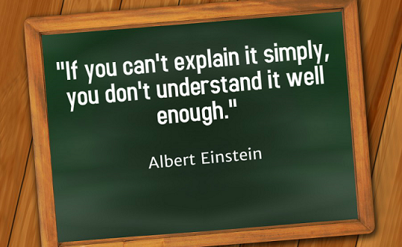
CONCLUSIONS: THE TAKE AWAY
1. Write in clear, concise, proofread language with seduc-
tive transitions.
2.
3. Show your expertise, previous contributions to the field.
4. Be sure to point out gaps, contradictions, and even out-
right falsehoods in the literature and your solutions.
5. Know your audience and the style and rhetorical de-
vices most appropriate for them.

Slide 70
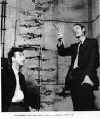
THREE STAGES OF SCIENTIFIC DISCOVERY¹
1. People deny that it is true.
2. People deny that it is important.
3. They credit it to the wrong person.
______________________________________________________________________________________________________
¹Ferris T. The Whole Shebang: A State of the Universe(s) Report. New York, Simon & Shuster, 1997, p. 173,

Slide 71
THE TAO OF EXACT SCIENCE
“With all due respect…it ain’t rocket surgery.”
-----Yogi Berra

Slide 72
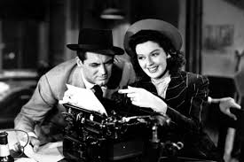
ACHIEVING THE END RESULT

